Slide 1




Desi Drillers Final Presentation
January 21st, 2024
Jawad Kazi
Ibrahim Chaudhry
Bilal Zafar
Ahmed-Wassim Benzerga

Slide 2
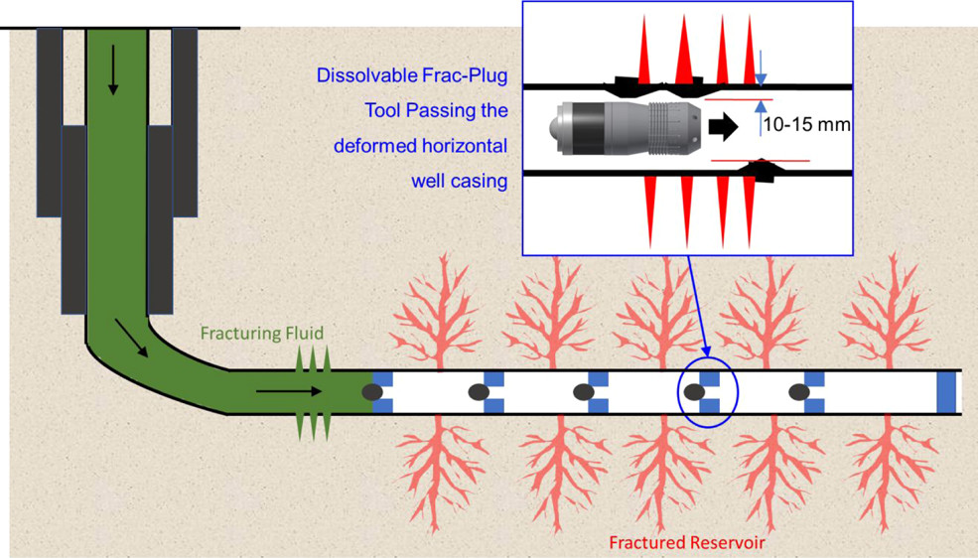
Executive Summary
Fluids are lost to formation when drilling out the plugs after fracking. We were to predict average pump difference during drill out based many possible predictor features for 15 wells.
We used Random Forest Regression and Bootstrap to predict the pump difference.
We found that the depletion of the wellbore was not necessarily related to the presence of a parent or co-developed well.
We recommend that feature engineering of these factors be used to optimize the fluid choice used in drill out
(pubs.acs.org)

Slide 3
Workflow
Import packages and load data
Basic data checking and visualization
Feature engineering and imputation
Regression analysis
Uncertainty analysis
Notes:
Bootstrap: sample with replacement 100x

Slide 4
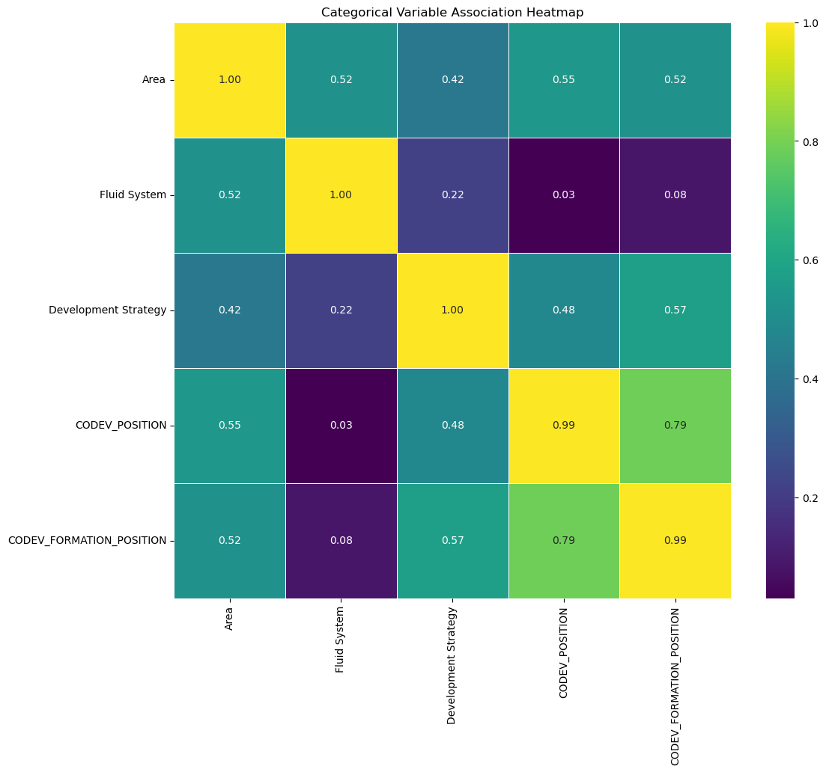
Categorical
Values
Depletion Attributes
Categorical Value heat map
looked categorical values
based off of age and proximity
viewed depletion
Correlation
categorical and and numerical values

Slide 5
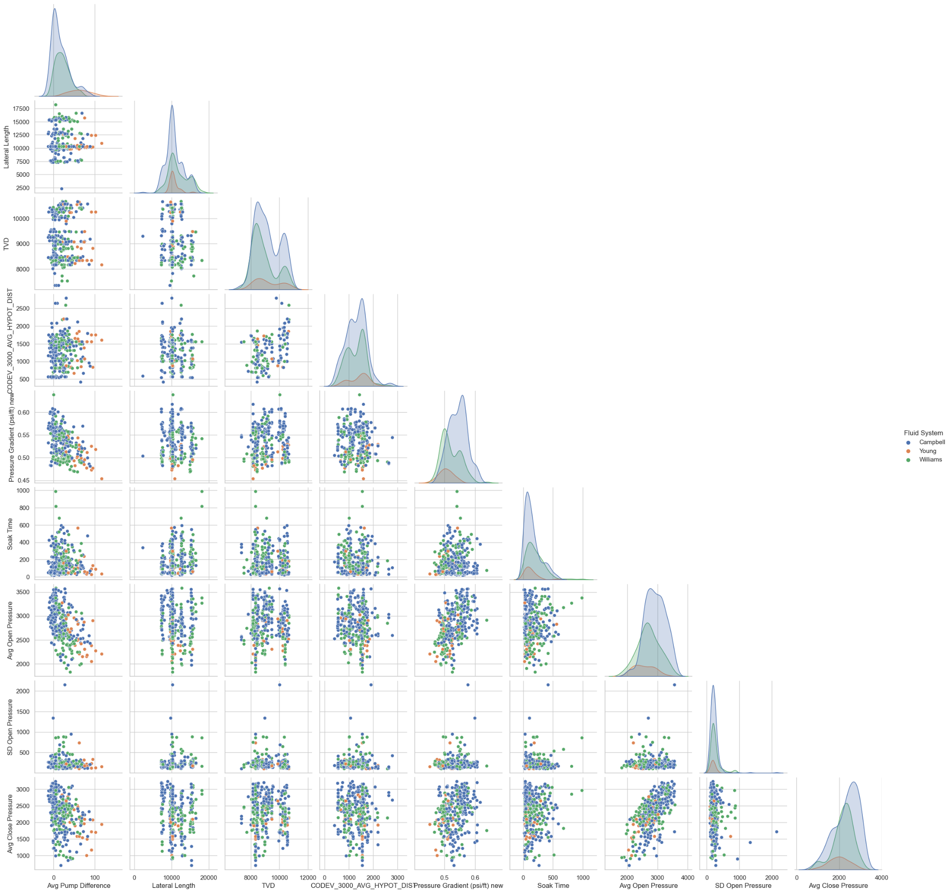

Slide 6
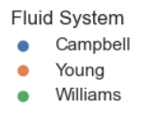
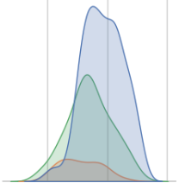
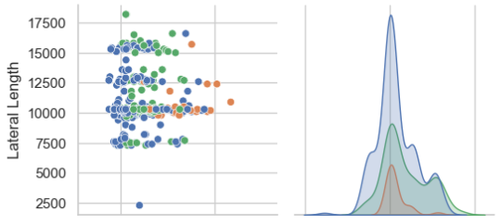


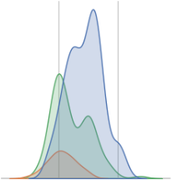
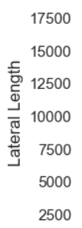

Slide 7
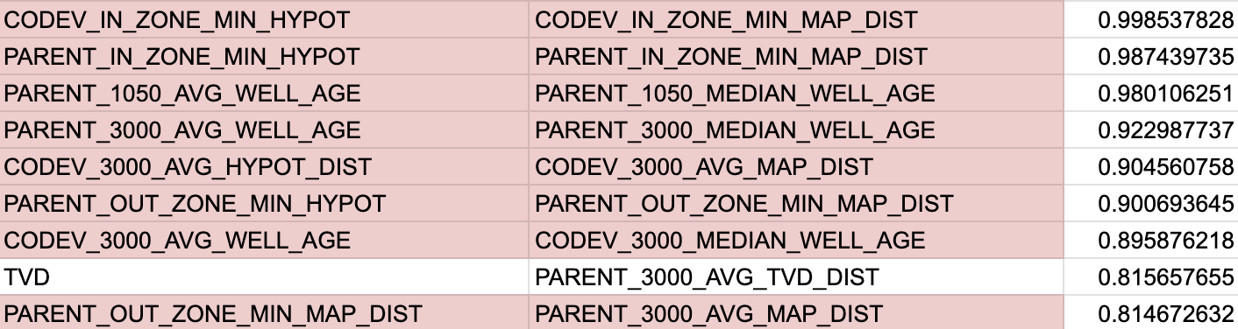
Remove Feature Terms to Reduce Collinearity
Subject TVD vs Avg Parent TVD
Valuable independently

Slide 8
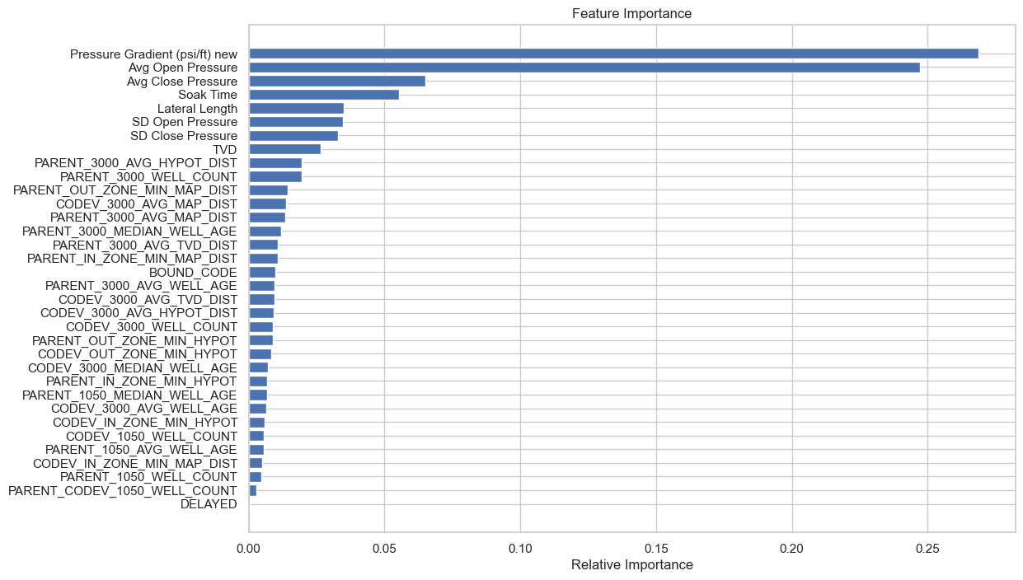
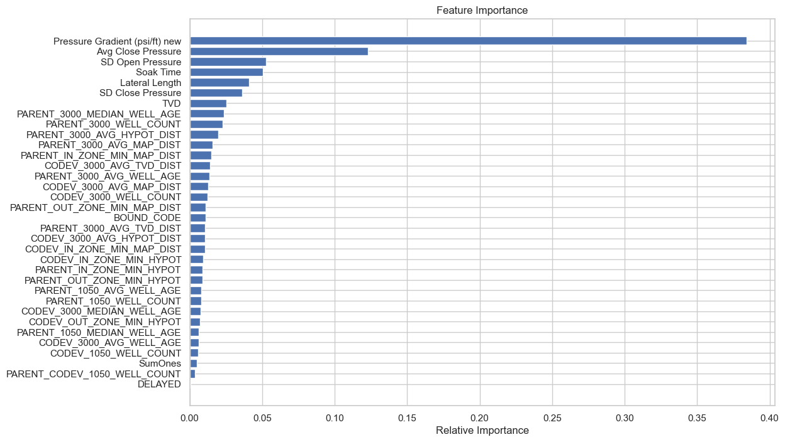

Slide 9
Deciding the Models
Ran multitude of Regression models
linear
lasso
ridge
KNN
Random Forest
XGB
Principal Component Analysis

Slide 10
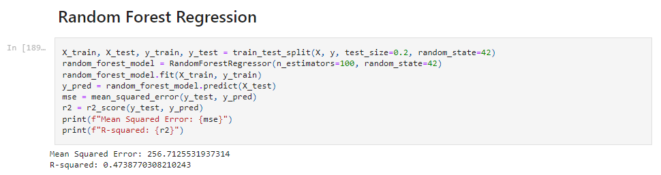
Results

Slide 11



Feedback
What did your team learn?
We found that the depletion of the wellbore was not necessarily related to the presence of a parent or co-developed well.
What did your team like?
We enjoyed the ability to use the machine learning models on real life data sets in a field that’s so fundamental to the functioning of our society
What could we do to improve next year?
More schedule options to mentor sessions

Slide 12
Questions

